Slide 1
Shampoo Sales Forecast
Team 4: Kanza Mazhar, Truc Vo, Mudiha Wazirali

Slide 2
Introduction
Company A carries many different types of beauty products such as cosmetics, skin care, fragrances, nails, bath and body, tools, haircare.
Company A has increased their sales over the last three years for their new shampoo product.
Company A wants to evaluate each of the product type to forecast the future sales and determine if it is still a good product that it needs to carry in the stores.
They have hired Group 4 Data Analyst team to conduct a time series analysis on their shampoo sales for the last three years and provide business recommendations.

Slide 3
Research Questions
Is there a trend in Company A’s shampoo sales over the last three years?
What time series model best fits this dataset?
What are the forecasted shampoo sales for Company A for the months of September, October, November and December 2019?

Slide 4
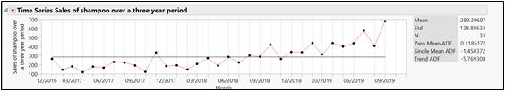

Initial Analysis of Dataset
Data was pulled on the 17th of each month from January 17, 2017 to October 17, 2019. The number of sales of shampoo over a period of a month at each index point in time is in terms of millions.
Mean increasing over time
Non constant variance
Differencing stabilized the variance

Slide 5
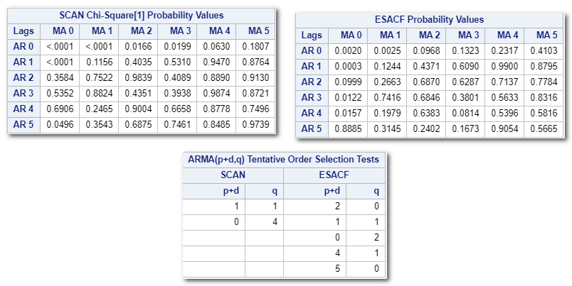
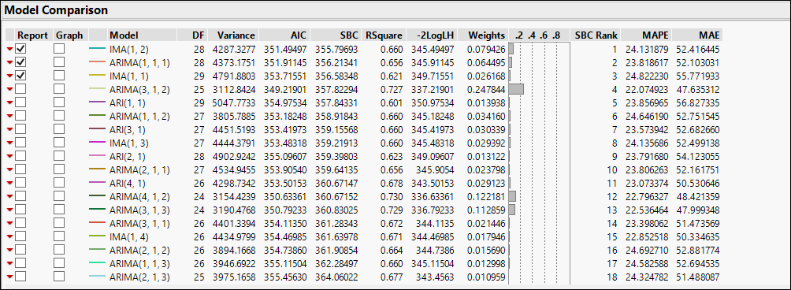
Model Selection
SCAN and ESACF Function
Performed SCAN and ESACF Function in SAS to quickly detect the models that are good to start exploring.
ARIMA Model Group
From SCAN and ESACF result in SAS, we explore ARIMA model group in JMP.
Sort ARIMA model group result by the lowest SBC
We explored and compared the first 6 models with the lowest SBC rank.
We did not find outliers or level shifts.

Slide 6
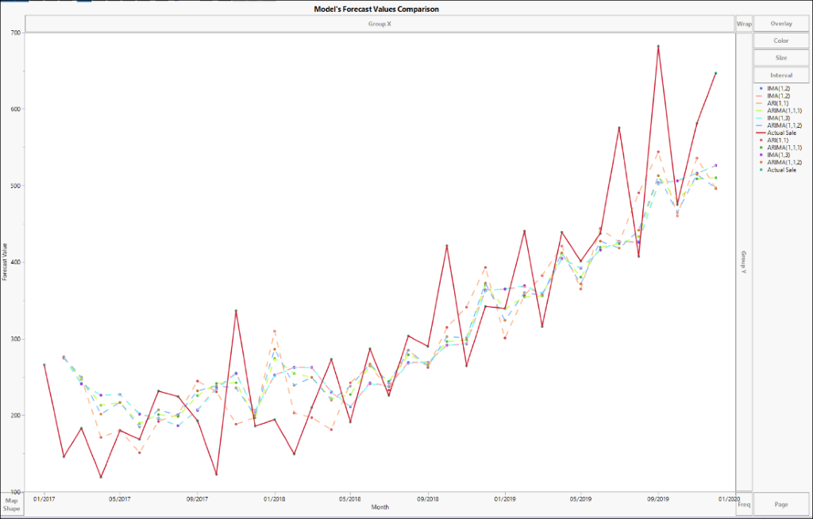
Model Selection
Forecast Comparison
Models
IMA(1,1)
IMA(1,2)
IMA(1,3)
ARI(1,1)
ARIMA(1,1,1)
ARIMA(1,1,2)

Slide 7
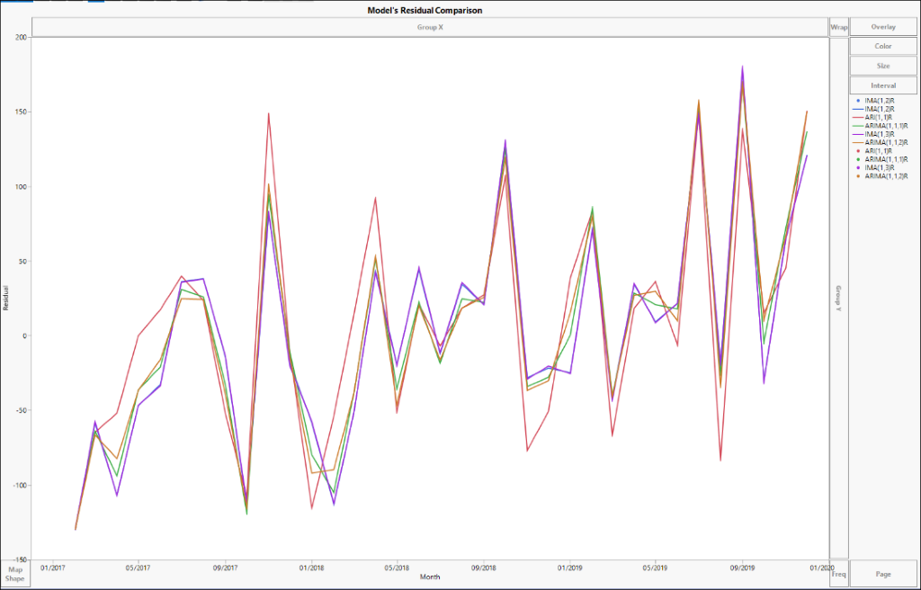
Model Selection
Residual Comparison
Models
IMA(1,1)
IMA(1,2)
IMA(1,3)
ARI(1,1)
ARIMA(1,1,1)
ARIMA(1,1,2)

Slide 8
Final Models
Recommendation
All 6 models seem to provide similar forecasting sale, however due to better predictions and residual analysis results, we decided to further explore IMA(1,2) and ARIMA(1,1,1).
Pros
Both stable and invertible.
Valid and parsimonious
The cost of processing not much greater than others.
Consistency in the residual difference as time proceeded.
Cons
Possible seasonality, outliers, and seasonality present but missed by models due to smaller dataset.
Dataset needs to be increased to improve prediction power of the mode.

Slide 9
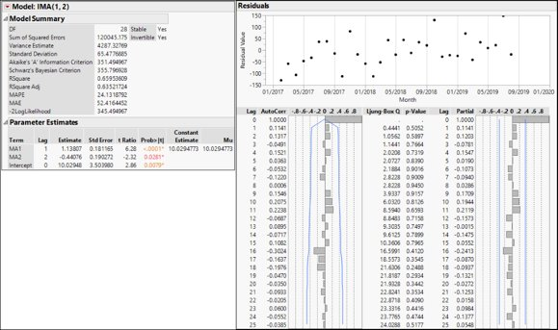
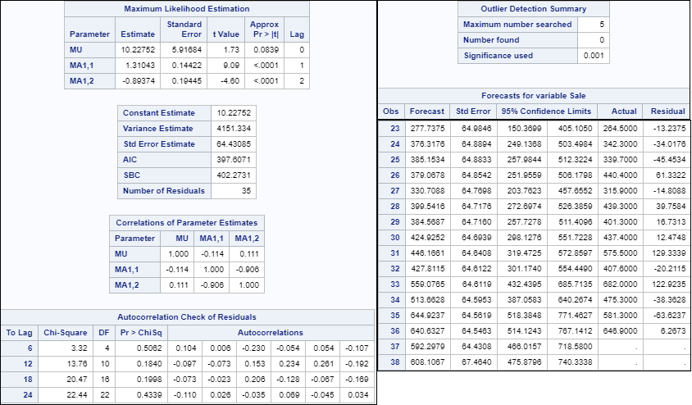
Final Models IMA(1,2)

Slide 10
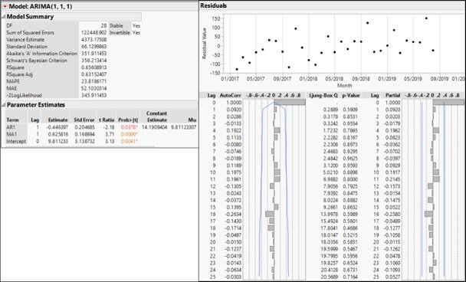
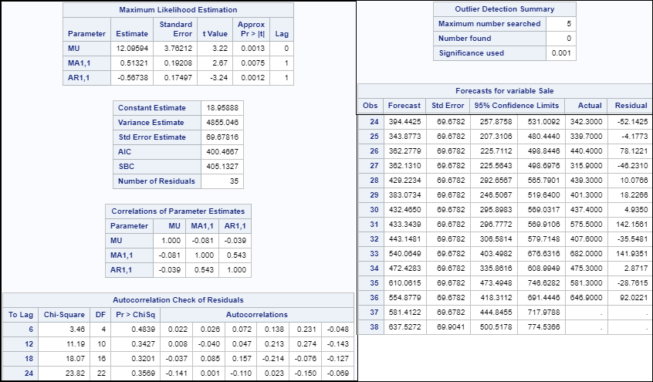
Final Models ARIMA(1,1,1)

Slide 11
Business Recommendations
The ARIMA(1,1,1) model shows a forecast of 512.7M sales for September, 480.1M sales for October, 508.9M for November, and 510.2M sales for December.
Overall, we see a steady projected increase in shampoo sales for Company A by the end of the year with sales nearly doubling in the last 3 years.
We recommend Company A to further invest in the shampoo sales market as our forecasts show an increase in sales and profits by the end of the year.

Slide 12
Future Work
For future work, we recommend Company A to review their sales by end of 2020 when they have more data for a model to be able to detect any underlying pattern or seasonality that our current recommended model is not able to detect.

Slide 13
Questions?

